Slide 1
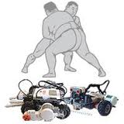
AUTONOMOUS
ROBO SUMOS
-Umesh Nair
-Sreeram Krishnan
-Vinod Salunke
(K.C. College Of Engg.)

Slide 2
About the Project…
Based on traditional Sumo-Wrestling.
There will be two robots that would be placed randomly in a circular ring.
Each robot would then try to push the other out of the ring.
When one of the robots goes completely out of the ring, the other is declared the winner.

Slide 3
Problem Statement
There will be two robots inside the circular part and each robot will be trying to push the other robot outside the circular shape. There will be a camera mounted on top of the square arena which will be exactly be perpendicular to the surface .
This camera will be keeping a watch on the movement of two robots and will be passing required information to it.
The wireless transmission between robo and the laptop/desktop using Zigbee module.It is a module that helps to transfer the data serially to any system wireless.
The application is user friendly and can be run found on any computers with Zigbee and robot connections.

Slide 4
Hardware Requirements
2 Spark V robots
4 Zigbee modules
1 Wireless Camera
Software Requirements
C Programming language
MATLAB/SCILAB
AVR Studio
AVR Bootloader

Slide 5
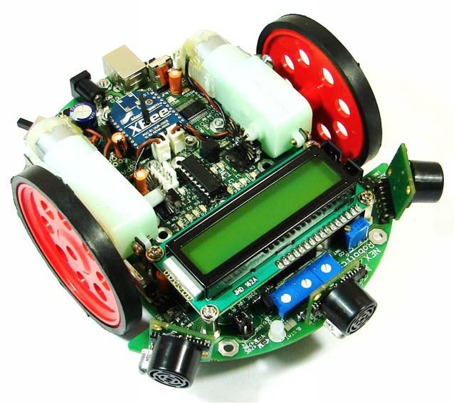
SPARK V ROBOT

Slide 6
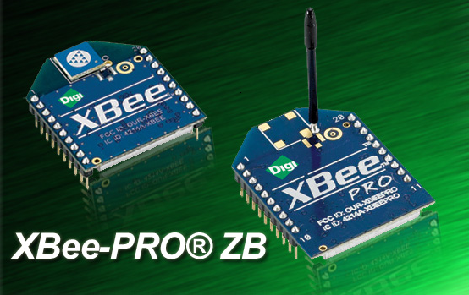
XBEE

Slide 7
Cost Analysis
Hardware Required | Quantity | Cost (Rs.)
Spark Robot Camera Zigbee module | 2 1 4 | 4,600/- 1,000/- 2,000/-
TOTAL |  | 8,000/-(Approx.)

Slide 8
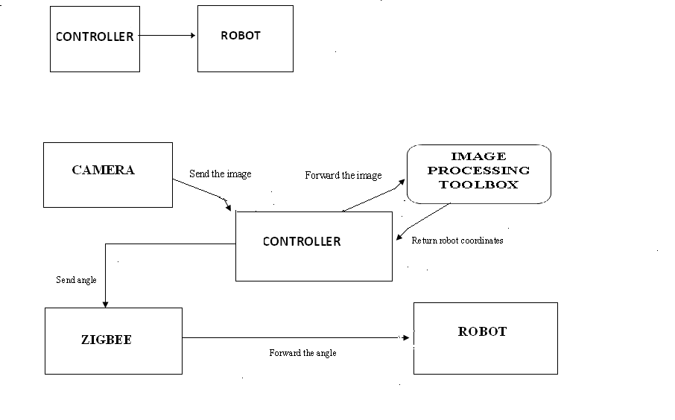
Data Flow Diagram
DFD level 0
DFD level 1

Slide 9
Task Specification
Setting up the arena.
Stay in the circular ring.
Hunt for the opponent.
Target/Aim at the opponent.
Attack/Push the opponent.
Testing both the robos in the arena.

Slide 10

Setting up the arena
Diameter:75-80cm
Colors:-
  Ring: Black
  Start line: Brown
  Boundary: White

Slide 11
Staying in the ring
White-line sensors will be used to detect the white boundary.
As soon as the sensor detects a white surface, the robot will know it is about to cross the ring boundary, and try to move inside the ring.

Slide 12
Hunting the opponent
Image processing will be used from an overhead camera to locate each robot.
The pixel position of each robot in the image will be normalized.
Normalized pixels will be converted into physical coordinates.

Slide 13
Targeting the opponent
Based on the calculated coordinates, the robot will rotate by an angle such that the opponent is straight ahead.
Pushing the opponent
The robot will move forward towards the opponent with a constant velocity to push it outside the ring.

Slide 14
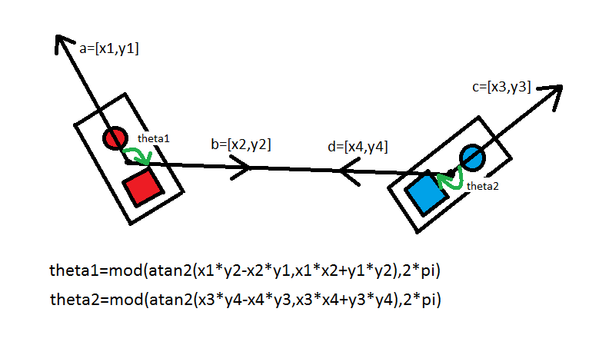
Calculating Angle of Rotation

Slide 15
Test Cases
Test Case No. | TC 001
Purpose | To test image processing
Situation | Both robots facing each other
Input | Coordinates of robots
Expected Output | Robots should move forward without any rotation
Test Procedure | Angle calculation(i.e. zero) Move forward

Slide 16
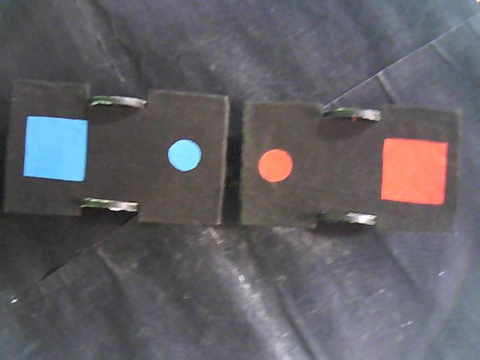
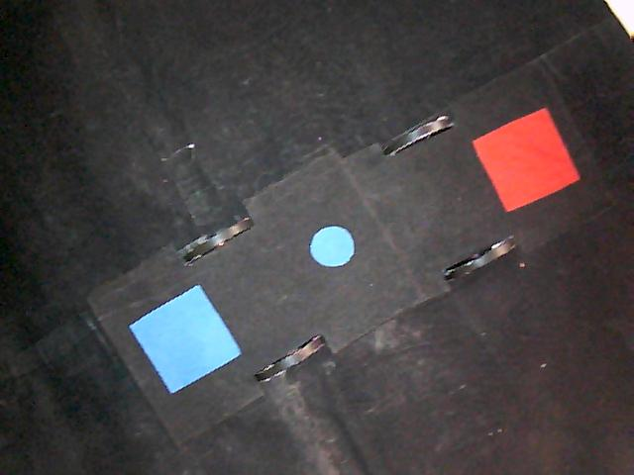
Situation
Output

Slide 17
Test Case No. | TC 002
Purpose | To test image processing
Situation | Both robots at angle with each other.
Input | Coordinates of robots
Expected Output | Both robots should rotate by appropriate angle such that they face each other, and then move forward
Test Procedure | Angle calculation Rotate by calculated angle Move forward

Slide 18
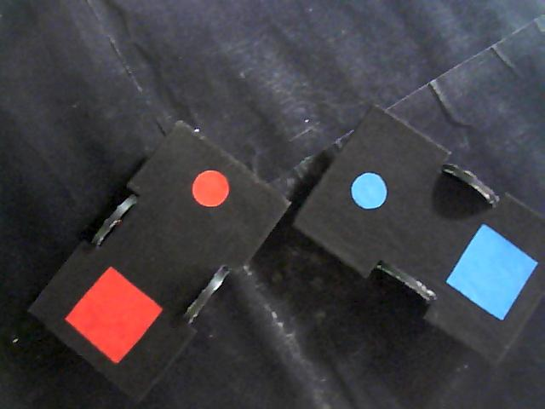
Situation
Output

Slide 19
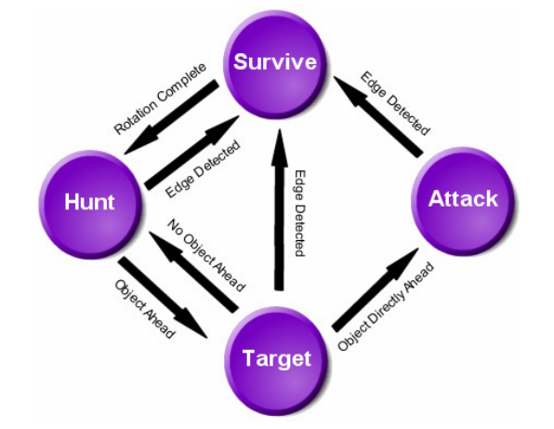
State Machine Diagram

Slide 20
FSM States
The robo sumo has four states:
SURVIVE
HUNT
TARGET
ATTACK.

Slide 21
SURVIVE
The robot enters this state when it detects the ring boundary.
Its goal is to survive by not going off the ring.
The robot rotates away from the sensor that sensed the edge to face back toward the center of the ring.
Actions:-
Rotate away from the line sensor that sensed the edge.
Switch to HUNT state when rotation is completed.

Slide 22
HUNT
The robot is not at the edge of the ring but hasn’t sensed its opponent.
The robo will make use of image processing to locate its opponent’s position relative to its own position.
Actions:-
Switch to SURVIVE state if ring boundary is detected.
Switch to TARGET state when opponent’s position is determined.

Slide 23
TARGET
The robot has sensed its opponent.
Now it will align itself to face the opponent straight ahead.
Actions:-
Switch to SURVIVE state if ring boundary is detected.
If the opponent is directly ahead and close, then switch to ATTACK state.
If the opponent is ahead but not close, move straight forward.
Otherwise switch to HUNT state.

Slide 24
ATTACK
The opponent has been found and aimed at.
Drive straight ahead with a force enough to push the opponent off the ring.
Actions:-
Switch to SURVIVE state if ring boundary is detected.
Otherwise, drive straight forward to push the opponent.

Slide 25
Challenges
Sensing the ring boundary.
Different positional strategies for both the robots.
Localization of the dynamic robots using image processing.

Slide 26
Applications
Security/Patrolling
Entertainment
Cleaning

Slide 27
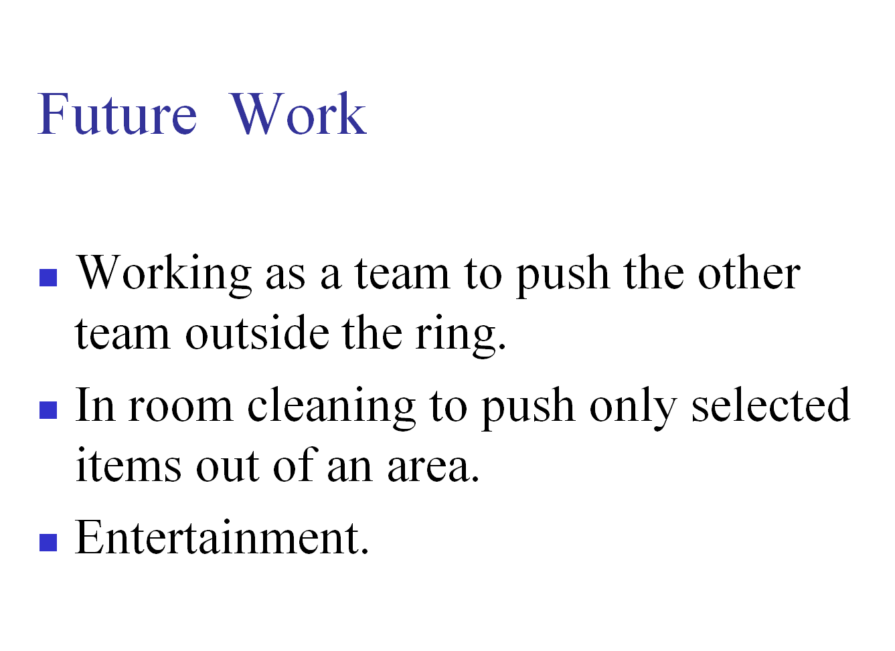

Slide 28
Conclusion
This project demonstrated the use of
Autonomous work of robot
Artificial Intelligence
Image Processing
Wireless data transmission using Zigbee

Slide 29
THANK YOU

